Slide 1
Stock Trading & Investment Performance Analytics System
- Rayapudi Rithika

Slide 2
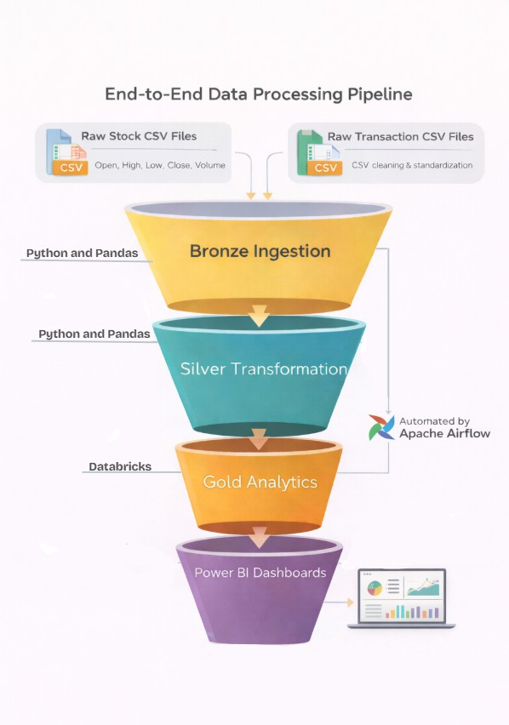
Workflow
Project Overview
This project focuses on building an automated analytics system for stock market and portfolio data
The system processes raw stock prices and trading transactions into analytics-ready insights
Emphasis is placed on:
Data quality and consistency Automated workflow execution Scalable analytics
Business-oriented visualization
The solution mirrors real-world financial analytics pipelines used in industry

Slide 3
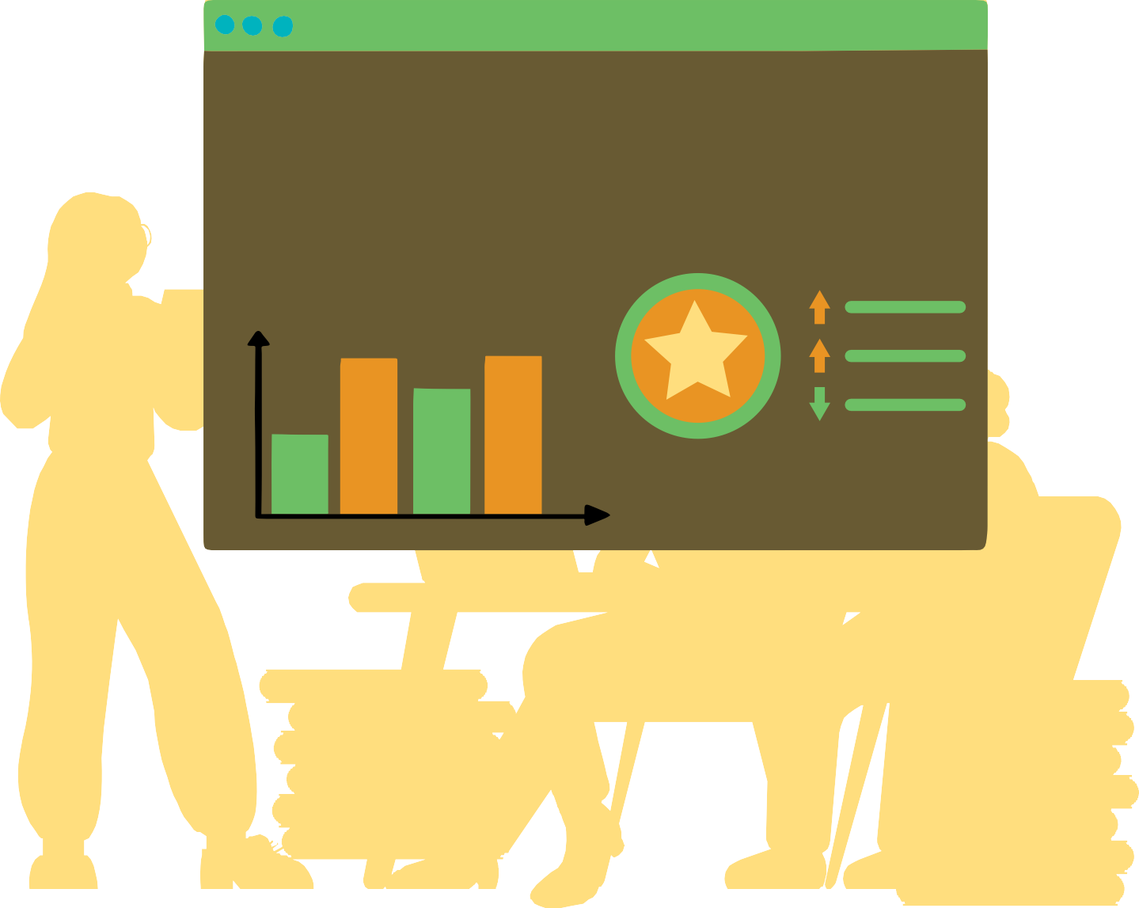


Problem Context
Stock market data is
time-series based and
sensitive to missing or irregular trading days Manual analysis is not scalable and often inconsistent
Portfolio data is usually fragmented multiple files
There is a need for: Automated processing
Reliable return and risk calculations A consolidated analytical view
across

Slide 4









Data Scope and Technology Stack
Data Scope:
Daily stock price data for: AAPL, MSFT, GOOGL
Attributes processed:
Open, High, Low, Close, Volume Simulated portfolio transaction data:
Buy/Sell trades, quantity, trade price
Data handled entirely using structured CSV-based workflows Technology Stack: Python, Pandas, NumPy, Apache Airflow, Databricks, CSV-based storage, Power BI

Slide 5
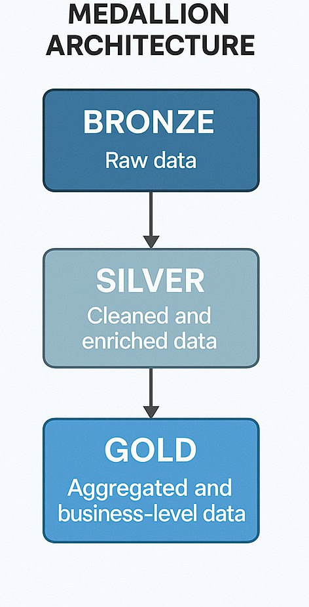
Pipeline Architectcure
Data quality
The solution follows the Medallion Architecture: Bronze: Raw data ingestion
Silver: Cleaning and standardization Gold: Aggregated analytics
Apache Airflow orchestrates the execution of all layers Azure Databricks is used for scalable analytics processing Power BI consumes gold-layer outputs for visualization

Slide 6
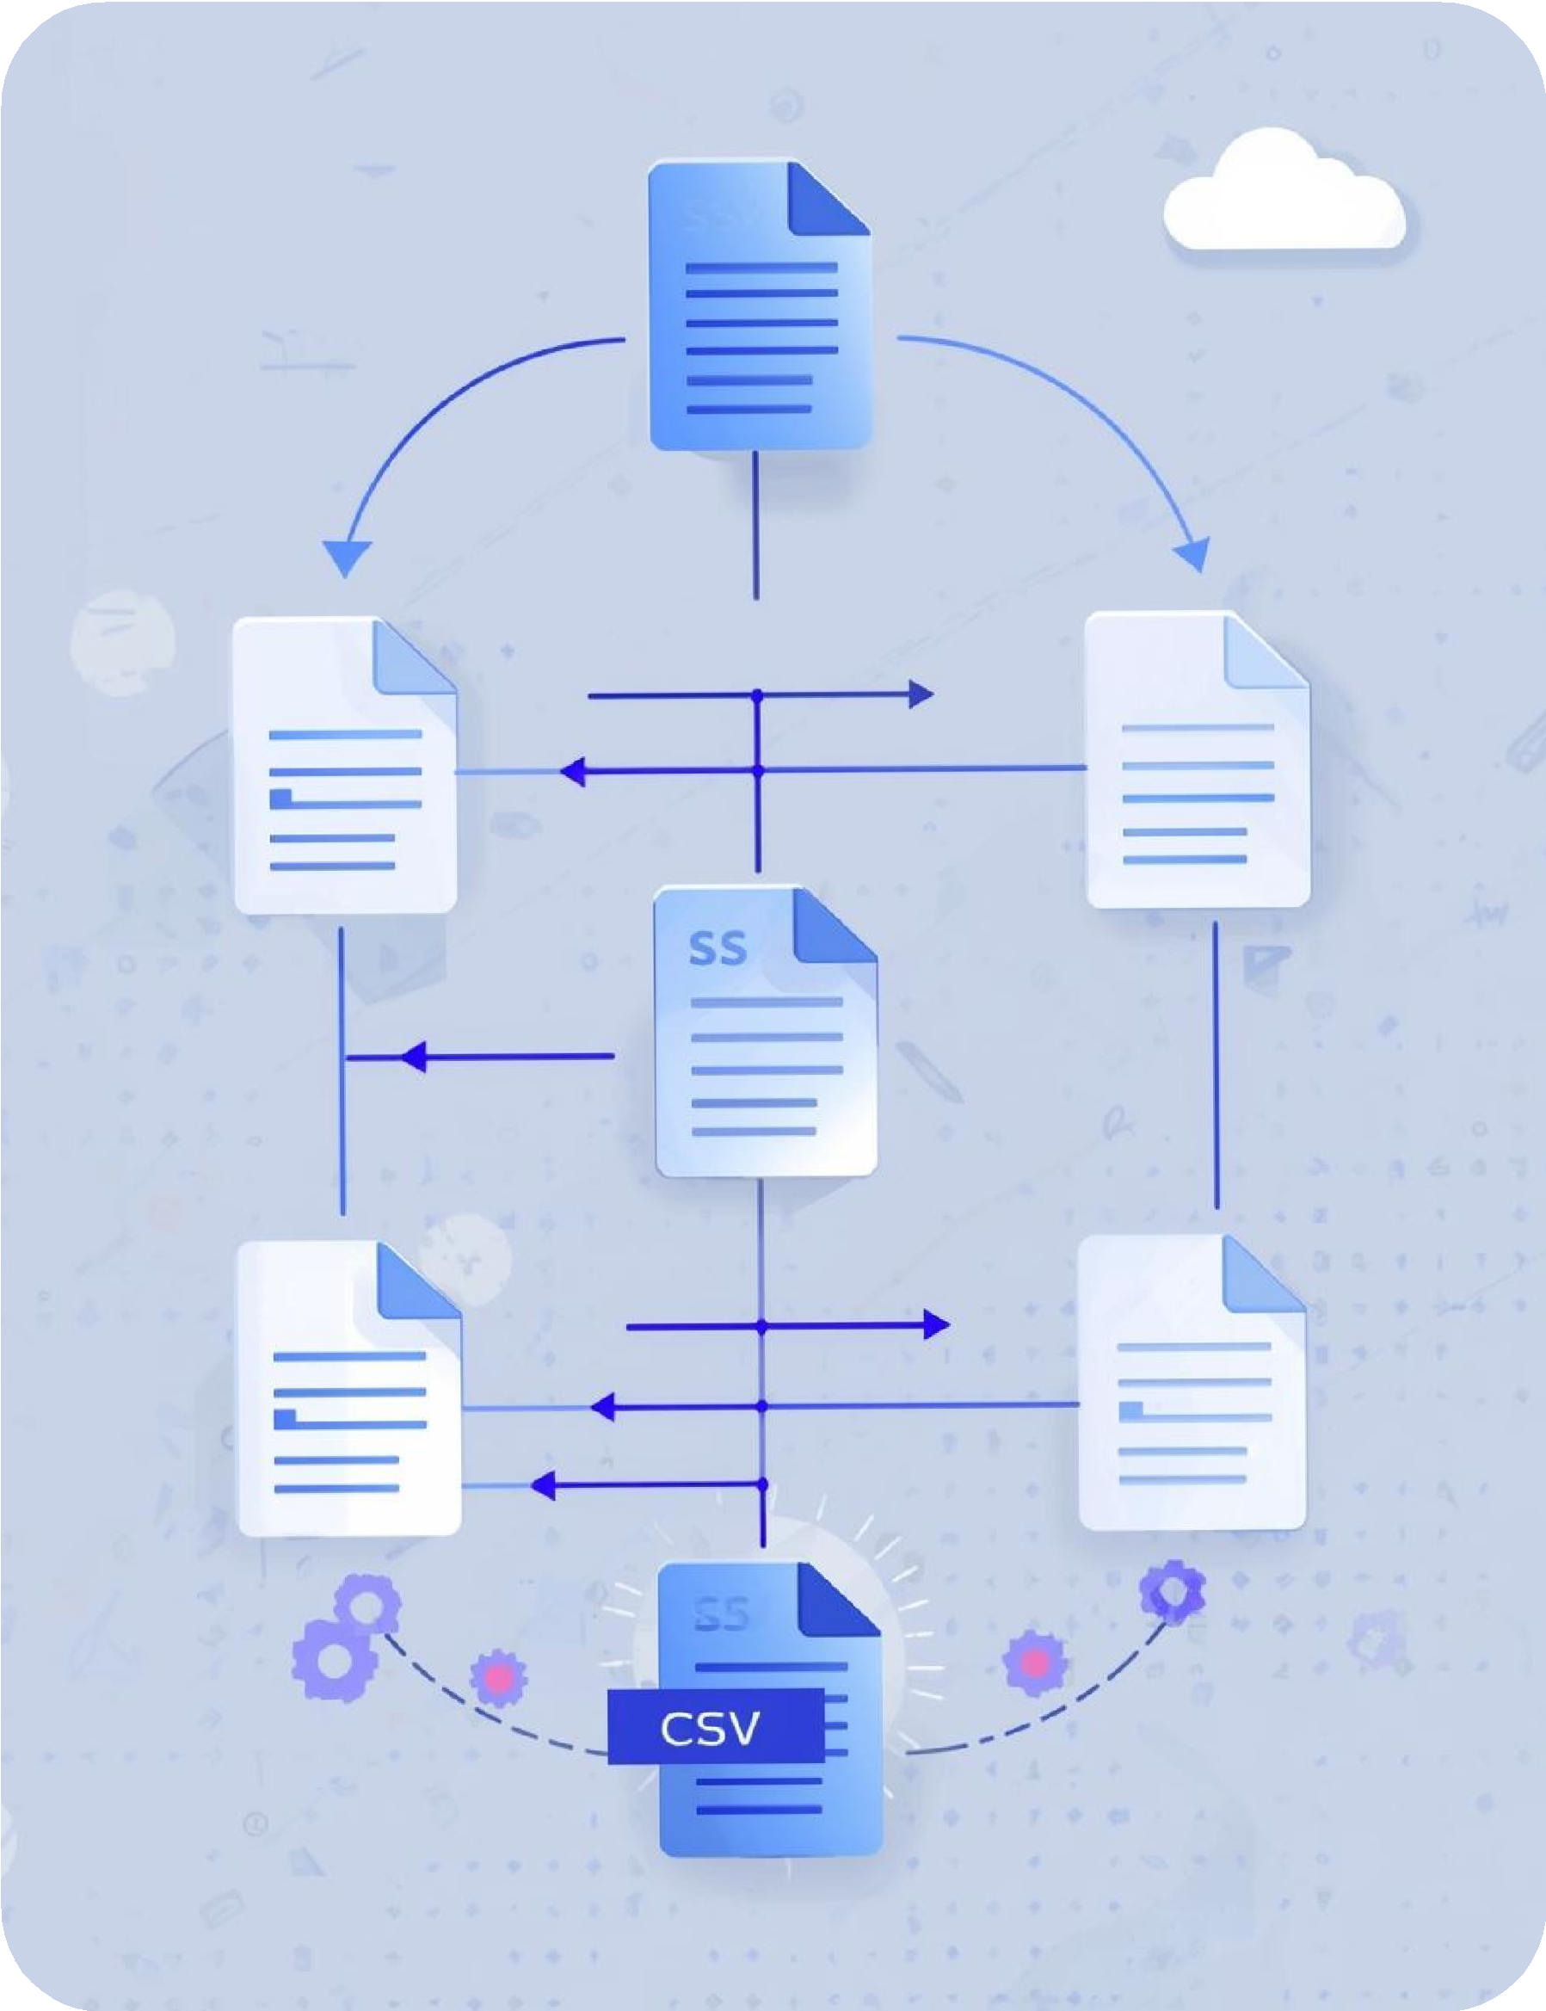
Bronze Layer: Data Ingestion
Individual stock CSV files (AAPL, MSFT, GOOGL) are loaded using Pandas
Each dataset is tagged with a stock identifier column All stock datasets are merged into a single DataFrame
Portfolio transaction data is ingested separately from CSV files
Data is written to processed storage without cleansing or calculations

Slide 7
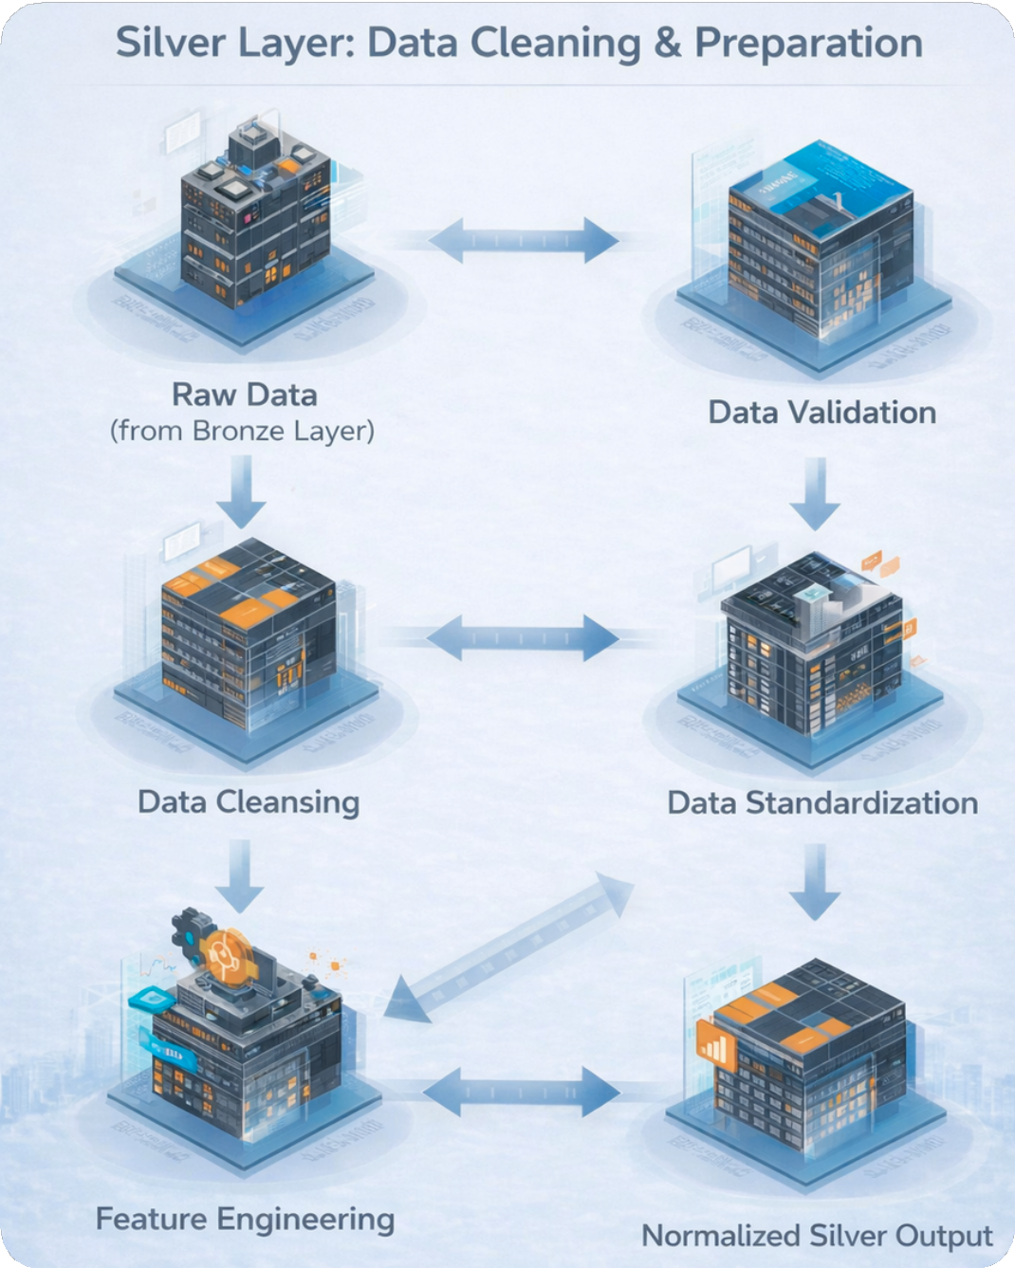
Silver Layer: Data
Cleaning & Preparation
Data type standardization and date parsing are applied Records are sorted by stock and trading date
Missing values in price and volume columns are handled Time-series continuity is maintained for return calculations Derived metrics are computed:
Daily returns Cumulative returns Moving averages

Slide 8





Portfolio Transaction Processing
Raw transaction data is ingested using Python Invalid records are removed based on:
Missing trade dates Invalid quantities or prices Incorrect trade types
Cleaned transaction data is prepared for portfolio analytics Enables accurate investment and profit/loss analysis

Slide 9
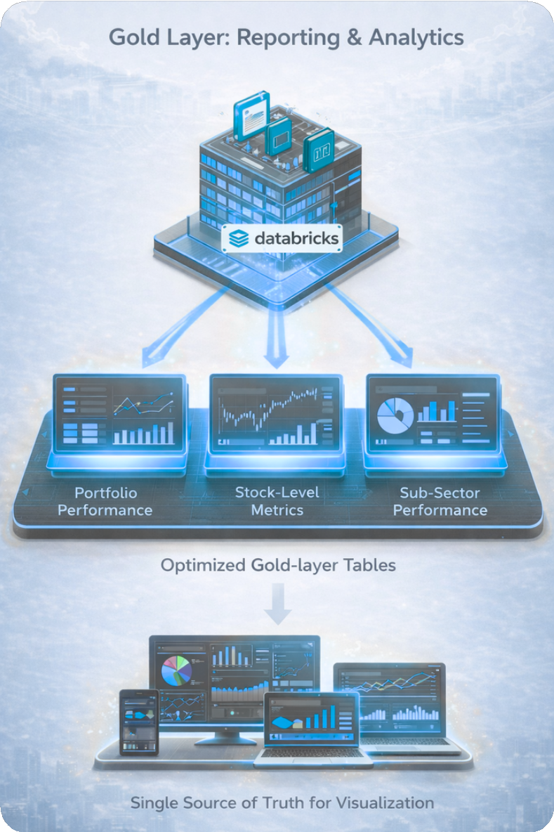
Gold Layer: Analytical Processing
Databricks notebooks are used for analytical transformations Aggregations and summaries are generated for:
Portfolio performance and profit/loss Stock-level performance metrics
Sub-sector performance analysis
Gold-layer tables are optimized for reporting and dashboards Outputs serve as a single source of truth for visualization

Slide 10
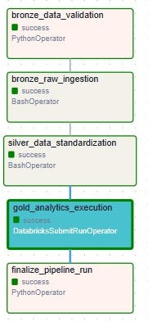
Workflow Automation
& Monitoring
Apache Airflow DAG orchestrates the entire pipeline Tasks include:
Bronze ingestion Silver transformation
Gold analytics execution Airflow provides:
Scheduling
Dependency management Retries and failure handling Execution logs for monitoring

Slide 11








Visualization
& Reporting
Power BI dashboards are built on gold-layer datasets Dashboards provide insights into:
Stock trends and returns
Portfolio allocation and performance Trading activity
Risk and market indicators
Visuals are designed for clarity and business interpretation

Slide 12
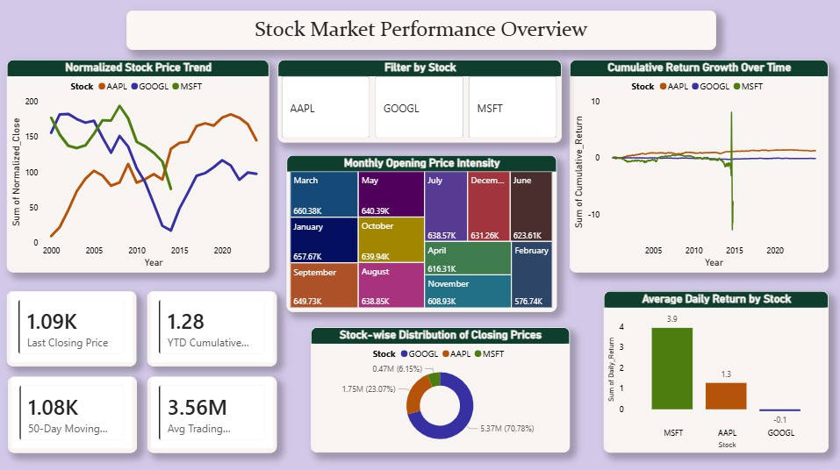
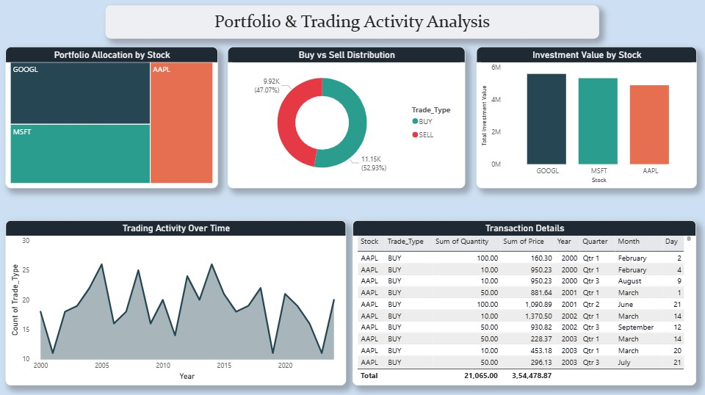
Dashboards
Stock Market Performance Overview
Provides a consolidated view of stock price trends, cumulative returns, and trading activity across selected stocks to understand overall market behaviour.
Portfolio C Trading Activity Analysis
Analyzes portfolio allocation, buy vs sell distribution, and trading frequency to evaluate investment behavior and transaction patterns.

Slide 13
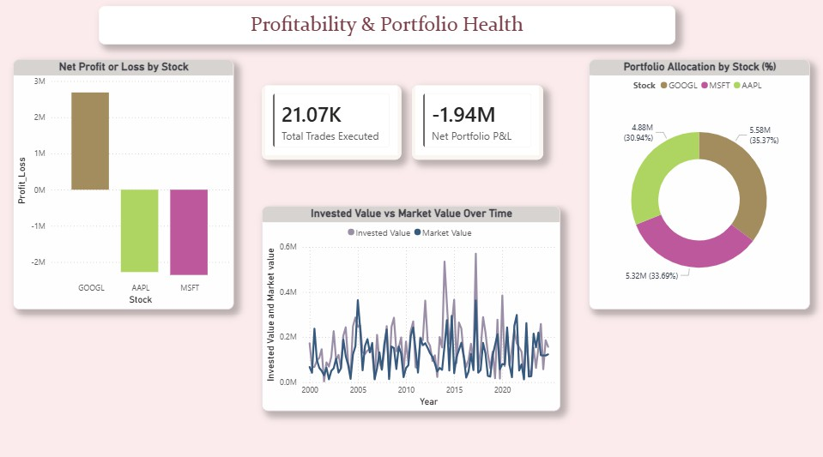
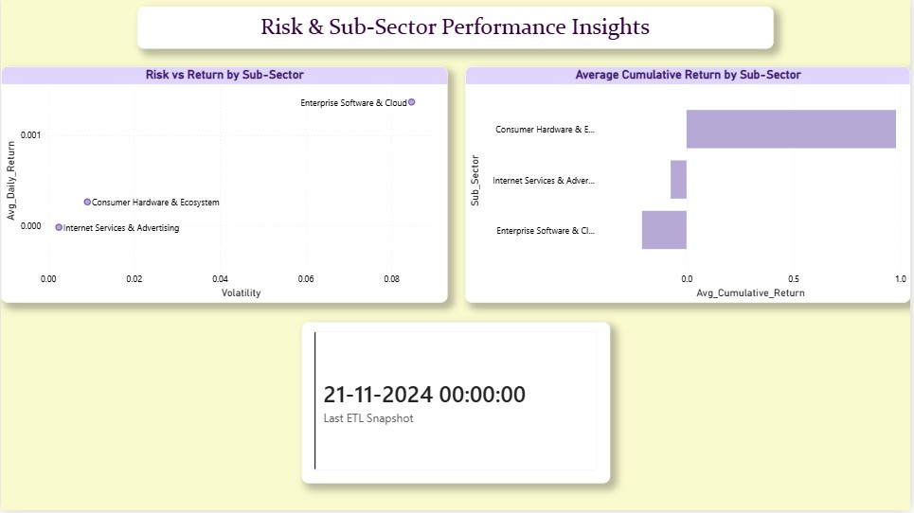
Dashboards
Profitability C Portfolio Health
Risk C Sub-Sector Performance Insights
Highlights portfolio profit or loss, invested versus market value trends, and overall portfolio health across stocks.
Compares risk, return, and cumulative performance across sub-sectors to identify
stable and high-risk investment areas

Slide 14





Conclusion
This project demonstrates a complete end-to-end analytics system for stock trading and investment performance analysis
Raw stock price and portfolio transaction data are systematically transformed into analytics-ready datasets using a layered pipeline
The Medallion Architecture ensures clear separation between ingestion, cleaning, and analytical processing Apache Airflow enables automated, repeatable, and monitored execution of the pipeline
Power BI dashboards convert processed data into actionable insights related to market trends, portfolio health, returns, and risk

Slide 15

Future Scope
Integration of real-time market data APIs for near real-time analytics
Expansion to include additional stocks, indices, or asset classes
Predictive analytics using machine learning models for return forecasting
Deployment on cloud-native data platforms

Slide 16
Thank you

